Slide 1
Music Generation
By: Daniel Chelling

Slide 2
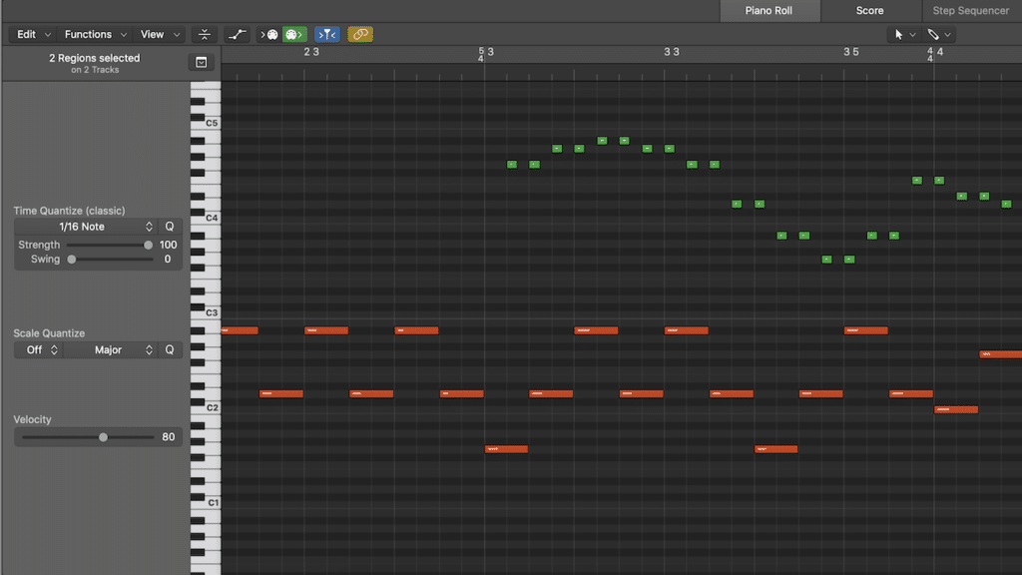
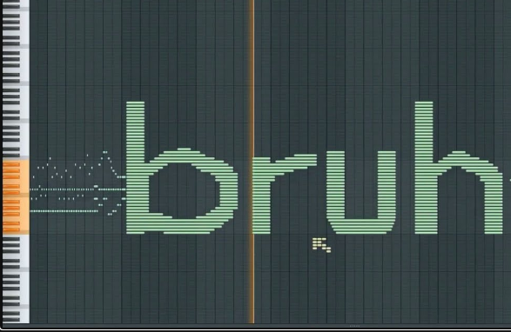
Project Explanation
Utilizing recurrent neural net architecture to create original music based on multiple datasets making a Midi -> Midi model.

Slide 3
State of the Art Solution
MUSNET – OpenAI
Transformer Model
Midi Files encoded as pitch, volume, and instrument in one token
Midi -> Audio/Midi
JukeBox – OpenAI
Raw audio + Lyrics
Audio -> CNNs -> Transformer -> CNNs -> Gen Audio
MAESTRO
Audio-Midi-Audio

Slide 4

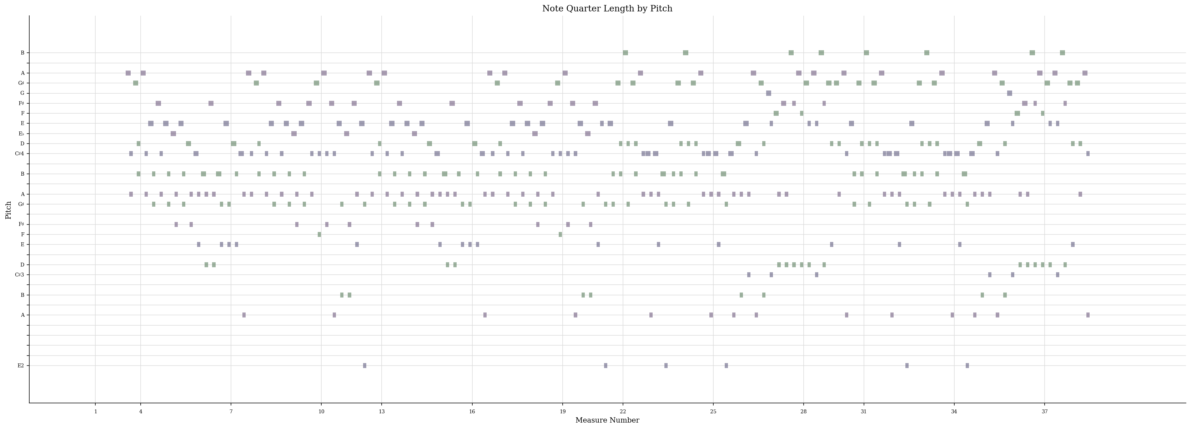
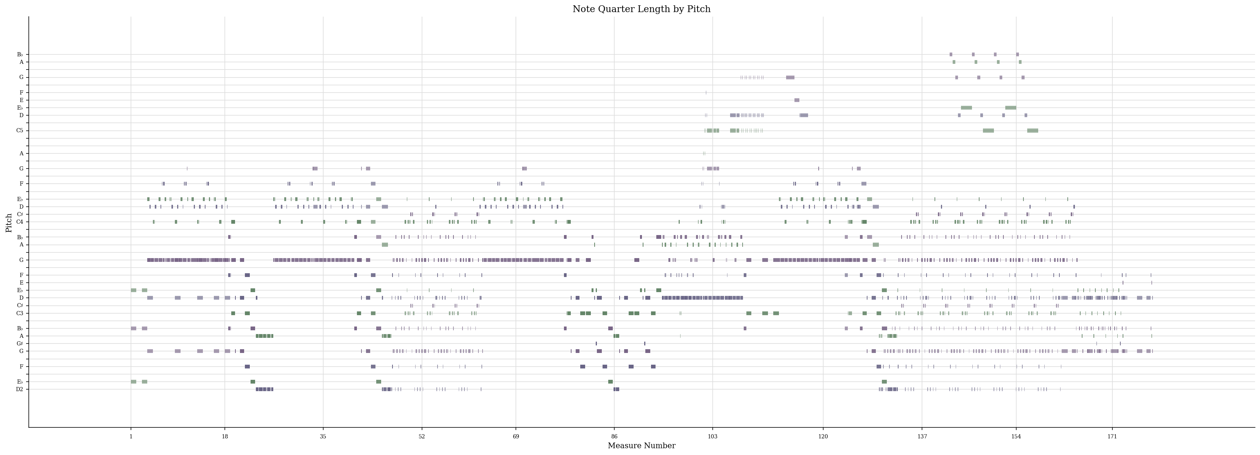
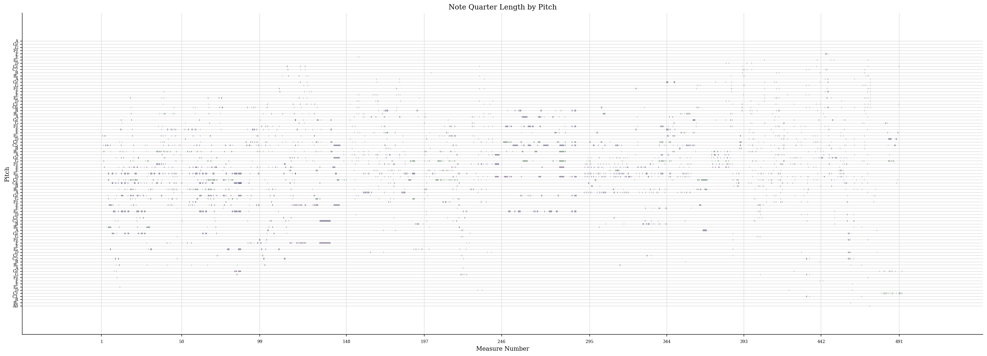
Dataset Explanation
Datasets
MAESTRO
Classical Guitar
Metal/Rock
Irish Songs
Francisco Tárrega

Slide 5
Data Preprocessing
Process each song into array
Ignore the time and keep it constant (all quarter notes)
Chords as one string of notes
Create mapping function
Sequence Data and One-Hot Encode

Slide 6
Model Layout
Two LSTM Layers (using CuDNNLSTM)
Dropout at 30%
Dense Layer
Model Checkpoints every Epoch
Softmax Activation

Slide 7

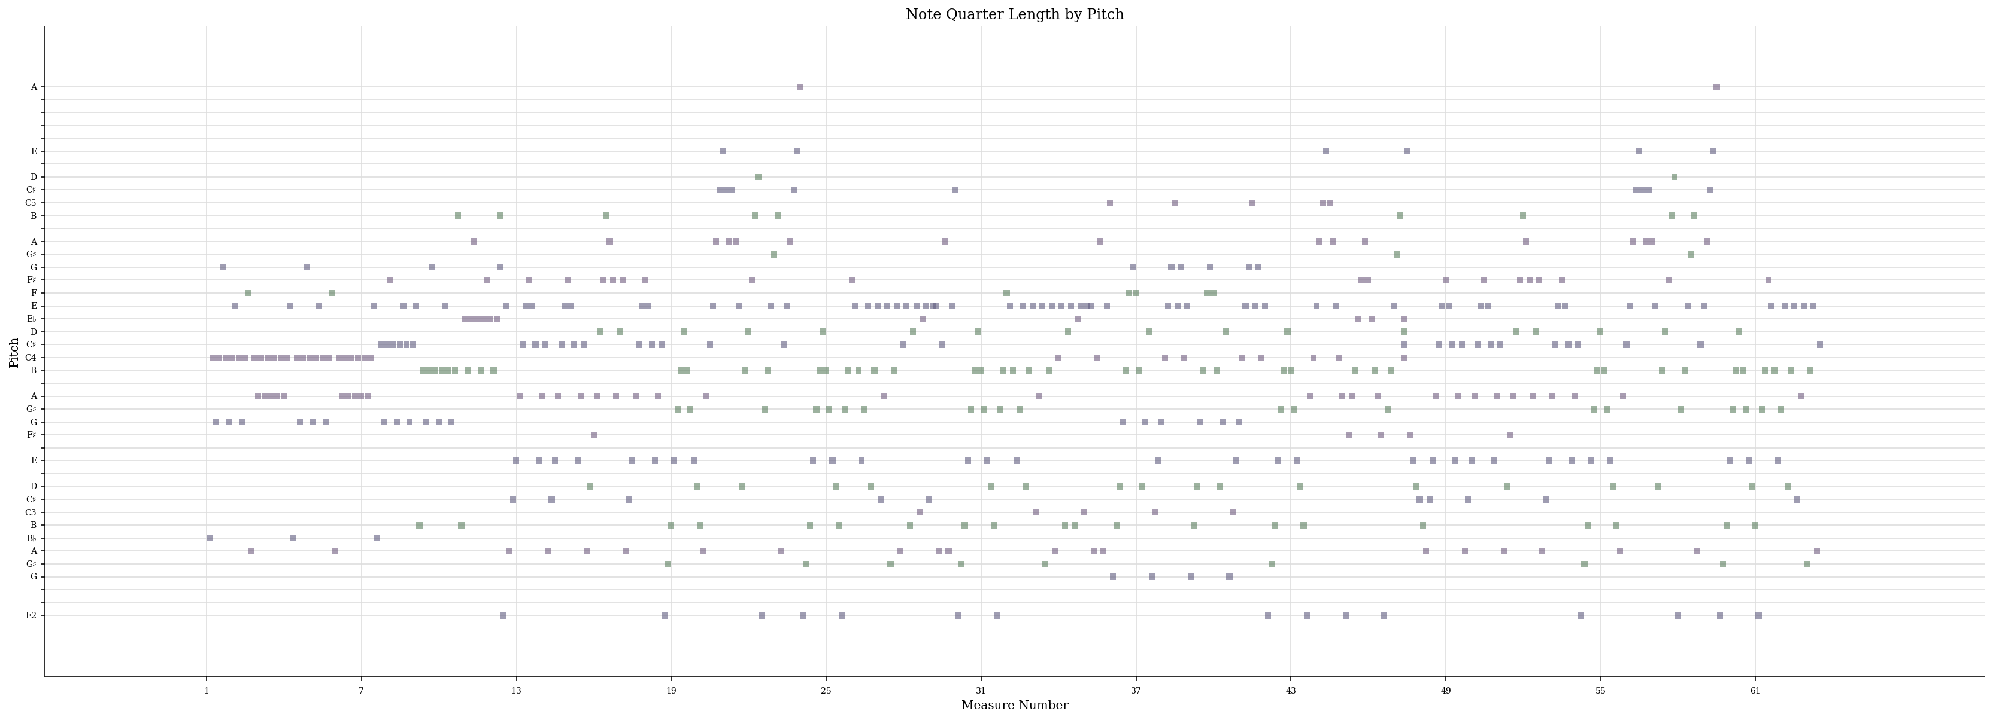
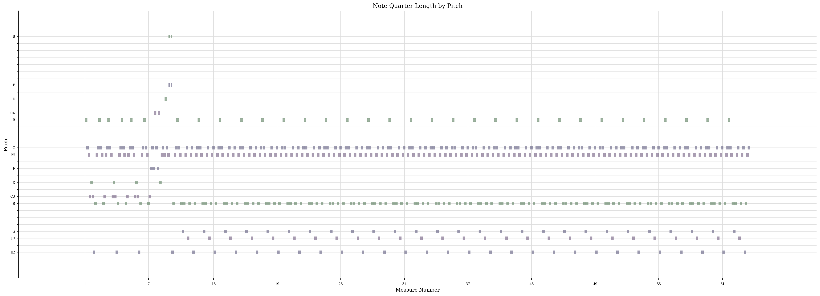
Results
Classical Guitar Model Metal Model Tárrega Model

Slide 8
Future steps for improvement
With Current Model Structure
Better Parsing Data to get rid of background noise from multi-instrument songs
N-gram similarity comparison
Expanding the Depth of the model and tweaking hyperparameters
Work with different new dataset found after I finished the model
Full Model Restructure
Change to Transformer Model
Encode song title and instrument with notes
Use a combination of the datasets found so far

Slide 9
GitHub Link With References
https://github.com/DChells/CPSC-393-Project

Slide 10
FIN

